Slide 1
Front End Testing @Jet.com Yuanyuan Li

Slide 2
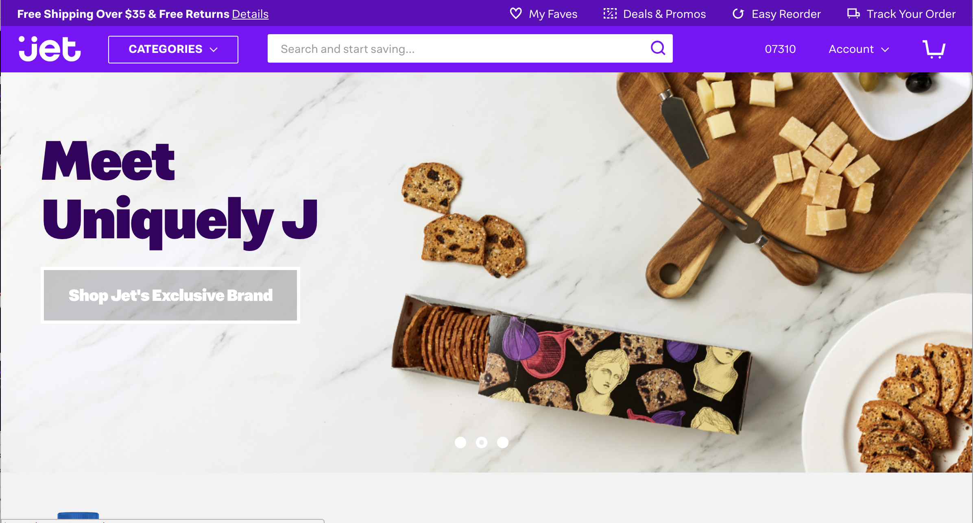

Slide 3
https://github.com/YuanyuanMaggie/meetup

Slide 4

Seen These Problems Before?
We released a new feature to prod, then found it broke something else
We fixed a bug, but the fix led to more bugs
We changed a teeny bit of code and now the SEO’s not working
This click works perfectly in Chrome, but is broken in IE

Slide 5
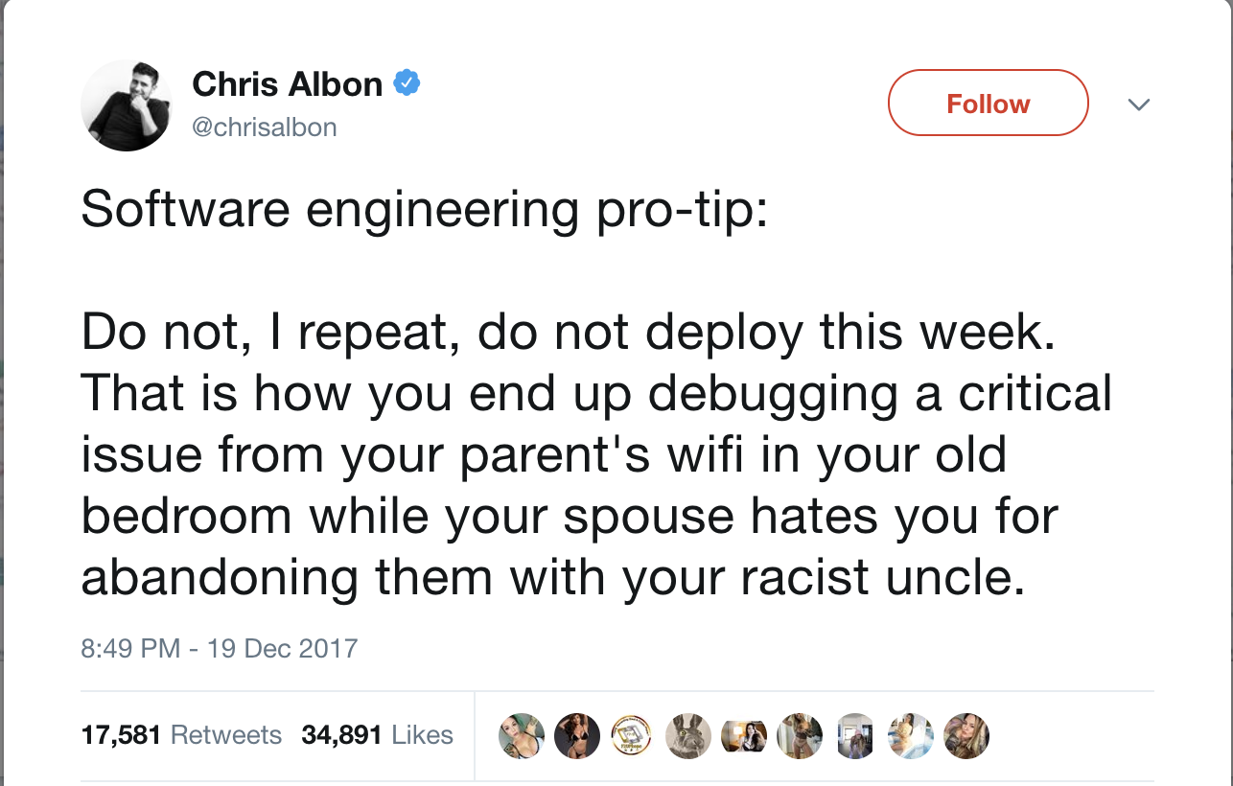

Slide 6
Q: How do you keep updates safe and stable?

Slide 7
Front End Testing
import test from 'ava';
import search from ’./lib/searchTerm.js';
const searchSample = {…};
const expectedRst = {...};
test('test search bold function', t => {
searchSample.forEach(item => search.changeBold(item, 'dog'));
t.deepEqual(searchSample, expectedRst);
t.pass();
})
import test from 'ava';
import search from ’./lib/search.js';
import searchClick from ‘./lib/searchClick.js’;
test('test search bold function', t => {
searchSample.forEach(item => search.changeBold(item, 'dog'));
const clickRst = searchClick(searchSample);
t.deepEqual(clickRst, expectedRst);
t.pass();
})
test('Link changes the class when hovered', () => {
const component = renderer.create(<Link page=”/home">Home</Link>, );
let tree = component.toJSON();
expect(tree).toMatchSnapshot();
}
Unit Tests
Integration Tests
Component Tests
End to End Tests
Web Performance Tests …

Slide 8
Front End Testing @ Jet’s Web Team

Slide 9
Batman Web testing cycle
Dev
Unit Tests
QA
Automated Tests/Visual Tests
Prod
Smoke Tests
Stakeholders tests
A/B Tests
End to End Tests

Slide 10
Batman Web testing cycle
Dev
Unit Tests
QA
Automated Tests/Visual Tests
Prod
Smoke Tests
Stakeholders tests
A/B Tests
End to End Tests

Slide 11

Testing In Dev
Unit Tests
Ava is a test runner for node.js
Minimal, fast and simple
Runs your tests concurrently
https://github.com/avajs

Slide 12

Testing In Dev
End to End tests
Automation framework:
Pros
Robustness
Strong community support
Same syntax for front-end /back-end unit testing
Cons
Slower learning curve
High complexity

Slide 13

Testing In Dev
End to End tests
2. Testing for Behavior:
BDD tests (Plain English)
@qa @sanity
Feature: Guest Checkout
As a customer
I want to be able to checkout as a guest
Background:
Given the guest checkout feature flag is set to true
And I am on the homepage
Scenario: checkout with an email
When I search Jet for “qa merchant”
And I click the add to cart button on the first result
Then I go to checkout
And I click checkout as a guest
Then I should be at shipping screen
When I submit the shipping form
Then I should be at payment screen
When I submit the payment form
Then I should be at review screen
When I place the order
Then My email is displayed after making my order

Slide 14

Testing In Dev
End to End tests
3. Automation tools:
Webdriver IO
it('should click my button', function () { var myButton = $('#myButton') myButton.click() // or browser.click('#myButton') var text = browser.getText('#someText');
assert(text === 'I was clicked'); // true })
Pros:
Based on selenium webdriver API
Support for most BDD and TDD test frameworks
Good community support
Fully extensible and flexible

Slide 15




Testing In Dev
t
Testing Stack
Node.js
Browser Driver
Browser
App

Slide 16
E2E Test Demo

Slide 17
Testing in Dev
npm run cucumber:qa -- --spec=test/checkout-guest.feature

Slide 18
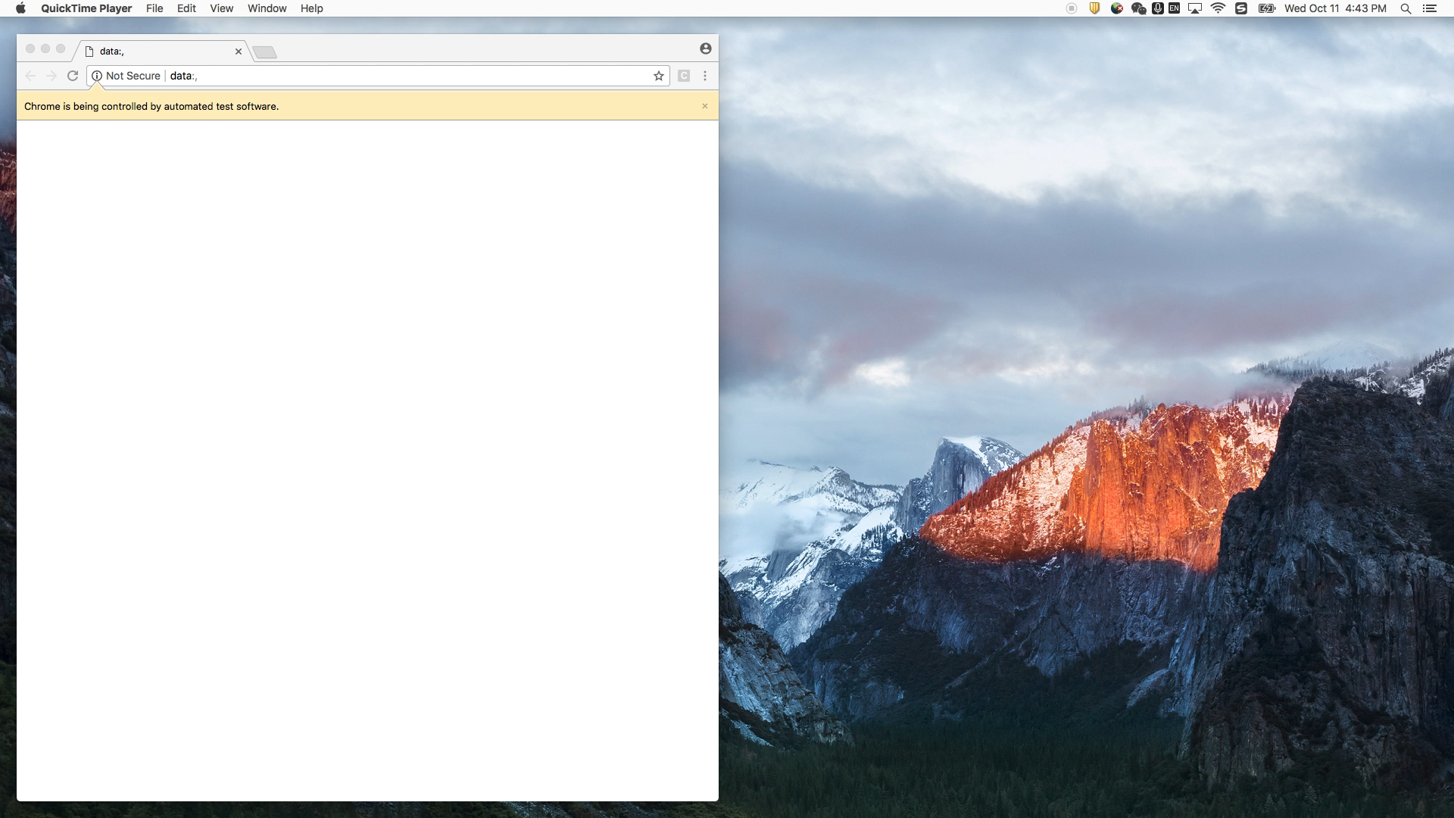
Testing in Dev

Slide 19
Testing in Dev
npm run cucumber:qa -- --spec=test/checkout-guest.feature
@qa @sanity
Feature: Guest Checkout
As a customer
I want to be able to checkout as a guest
Background:
Given the guest checkout feature flag is set to true
And I am on the homepage
Scenario: checkout with an email
When I search Jet for “qa merchant”
And I click the add to cart button on the first result
Then I go to checkout
And I click checkout as a guest
Then I should be at shipping screen
When I submit the shipping form
Then I should be at payment screen
When I submit the payment form
Then I should be at review screen
When I place the order
Then My email is displayed after making my order

Slide 20
Testing in Dev
Step definitions
module.exports = function checkoutSteps() {
this.When(/^I click checkout as a guest$/, () =>
new Checkout().getCheckout().then(c => c.clickGuestCheckout(‘#login’))
);
}
class Checkout extends FullPageObject {
constructor() {
super('checkout', '/checkout');
}
getCheckout() {
return new CheckoutLogin()
}
}
class CheckoutLogin extends ElementPageObject {
clickGuestCheckout() {
return this.click(this.guestCheckoutSelector);
}
}

Slide 21
Batman Web testing cycle
Dev
Unit Tests
QA
Automated Tests/Visual Tests
Prod
Smoke Tests
Stakeholders tests
A/B Tests
End to End Tests

Slide 22




Automated Tests in QA
Git Repo
Automation Server
QA App Deploy

Slide 23

Automated Tests in QA
Stakeholders
QA App
Features Break
Bug Break
SEO Break
IE Break
End to End Testing
Kicks off
testing
Records test videos
Tests

Slide 24
Problems Solved
We released a new feature to prod, then found it broke something else
We fixed a bug, but the fix leads to more bugs
We changed a teeny bit of code and now the SEO’s not working
This click works perfectly in Chrome, but is broken in IE

Slide 25
Batman Web testing cycle
Dev
Unit Tests
QA
Automated Tests/Visual Tests
Prod
Smoke Tests
Stakeholders tests
A/B Tests
End to End Tests

Slide 26
Takeaways

Slide 27
Key Takeaways
A stable Front End requires tests – no ifs or buts
Use automated tests if you can
Docker/Container are good tools to build your app for QA
Resources:
CucumberJS: https://github.com/cucumber/cucumber-js
MochaJS: https://mochajs.org/
Webdriver IO: http://webdriver.io/api.html
Docker: https://docs.docker.com/
Jenkins: https://jenkins.io/doc/
Nomad: https://www.nomadproject.io/
SauceLab: https://saucelabs.com

Slide 28
Keep in touch! LinkedIn: yuanyuanmaggie https://github.com/YuanyuanMaggie/meetup

